Slide 1

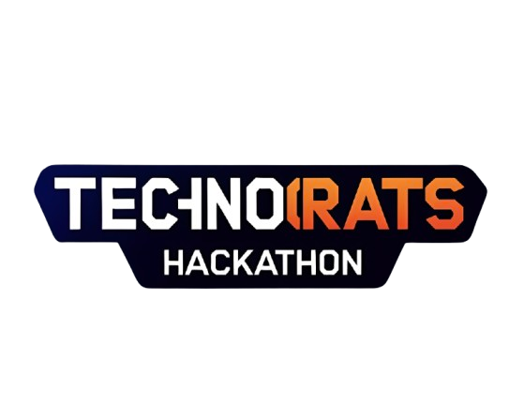
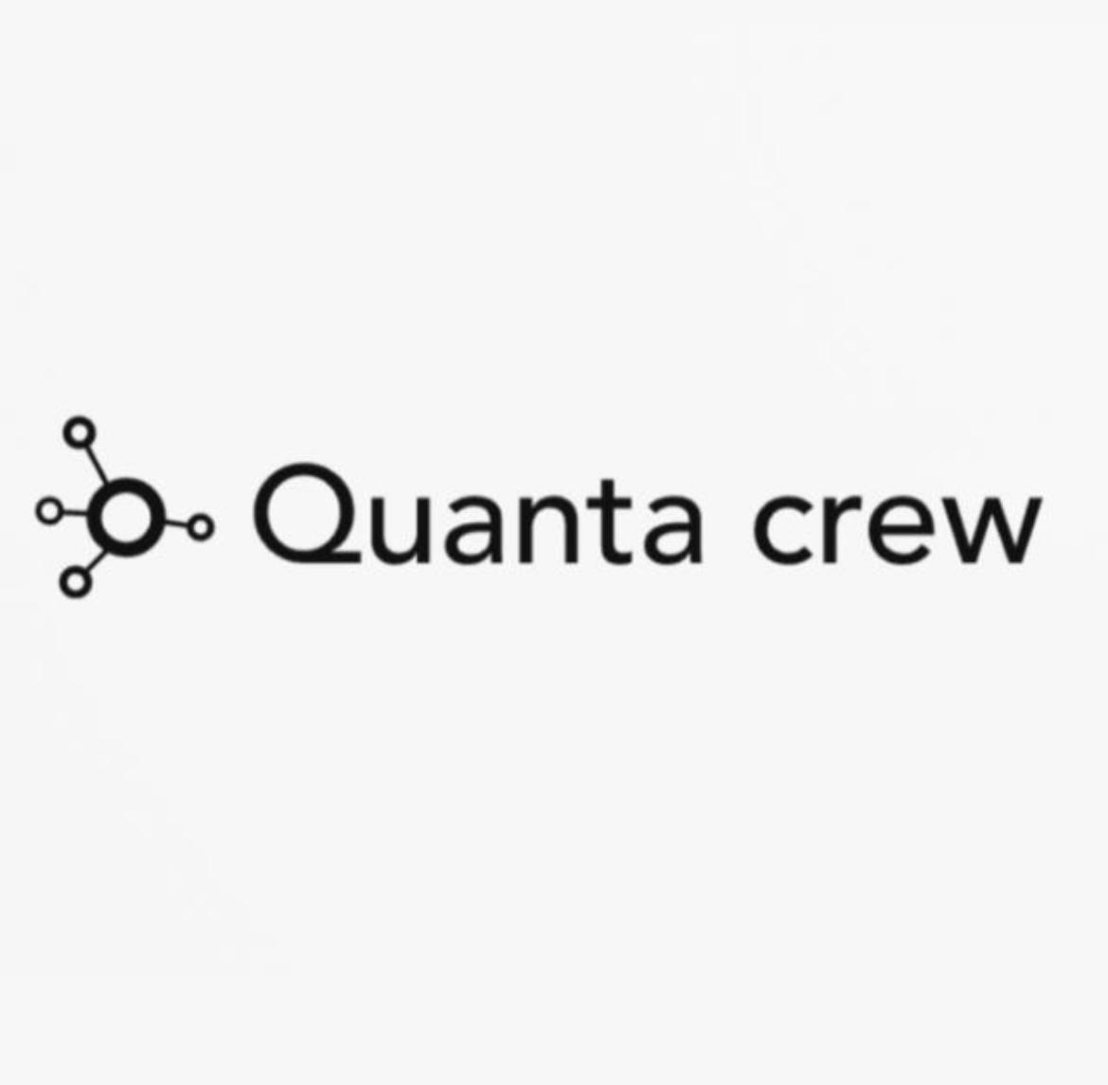
FalconClean
Interactive Dataset Curator for Duality AI Synthetic Data
TEAM NAME: SynthVision
THEME/TRACK: Duality AI (AI/ML)

Slide 2
Problem Statement
Current Pain Points in Duality AI Workflow
Manual download, rename, and upload of output.zip takes 10-20 minutes per session.
Generated images often include low-quality, duplicate, or mislabeled samples.
Quick visualization of bounding boxes before training is difficult.
Merging multiple sessions is tedious (duplicate filenames, train/val splits reset numbering).
Sharing and collaboration on curated datasets is not easy.
Top performers spend hours on data wrangling instead of modeling.
Result: Severely limits experimentation speed and leaderboard performance.

Slide 3
Proposed Solution
FalconClean – Interactive Dataset Pipeline for Duality AI
A web + notebook hybrid tool to quickly process Falcon sessions:
Instant download via Google Storage URL (3–5 sec).
Interactive UI for visual image pruning (Accept/Reject with bounding box overlay).
Auto-merge unlimited sessions with unique prefixing and proper train/val handling.
Visualize statistics (class distribution, bbox sizes, image quality).
Export clean, ready-to-train dataset (YOLO format) or upload to Kaggle.
Share curated dataset with a single link.
Reduces hours of manual work to under 5 minutes.

Slide 4
Tech Stack
Frontend / Interactive UI: Streamlit (primary) + ipywidgets (Colab backup)
Core Libraries: Python, OpenCV, Albumentations, Pandas, Plotly
Bounding Box Visualization: Custom YOLO drawer (multi-class/color support)
Downloading: requests + Google Storage public URLs
Merging & Renaming Logic: Custom prefix-based system (set_001_, set_002_, etc.)
Deployment Options: Streamlit Community Cloud (free), Google Colab, HuggingFace Spaces
Optional Future: FastAPI backend + user accounts

Slide 5
Expected Outcome / Impact
Why This Stands Out
Accelerates dataset creation 10x–20x for Duality/Falcon users.
Proven to directly boost leaderboard rankings.
Enables easy collaboration via URL sharing of curated 10k+ image datasets.
The first visual pruning tool specific to Falcon's output.
Open-source for quick adoption in Duality Discord & Kaggle.
Potential for official Duality AI recommendation or platform integration.
Significant real-world impact on synthetic data quality for robotics and autonomous systems.

Slide 6
Team Details
Team Lead: Muhammad Haaris
College Name: Institute of business administration (IBA) karachi
Email: m.haarisasif@gmail.com
Phone:+92 3362888038

